Slide 1

Cleaning Up Code with Exception

Slide 2
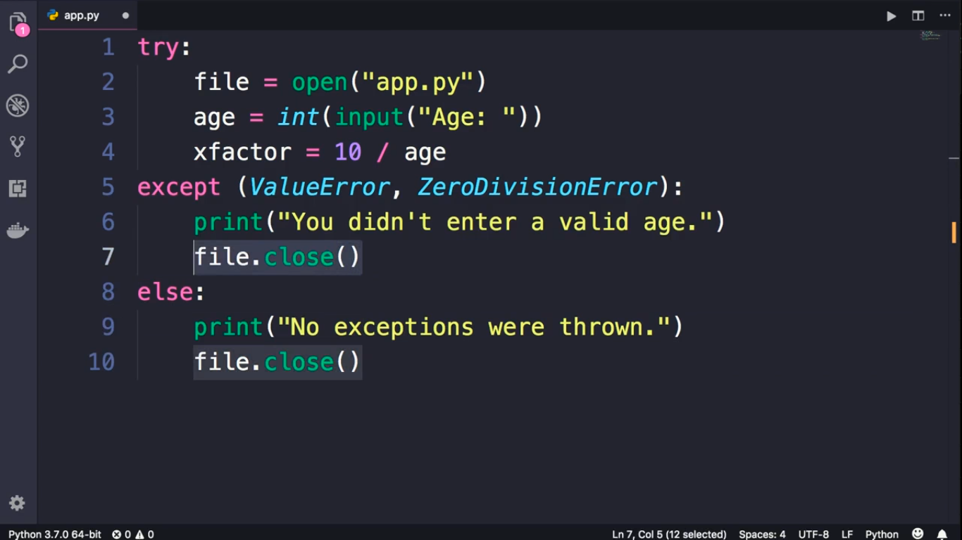

Slide 3
